Slide 1

Vue Component Communication
M3-12
Participate! The more engagement the better! You are NEVER interrupting me!

Slide 2
Important Dates
Next Friday 9:00AM (No exceptions) - All HW exercises and any resubmits are due. Nothing will be accepted or rescored after this time. Next Friday afternoon is capstone kickoffs. Each team will do a sprint planning meeting that afternoon. Plan on being here the full afternoon and for each day the two remaining weeks.

Slide 3
Objectives
Nested Components
Single Responsibility Principle
VueX
Component Design
Props

Slide 4
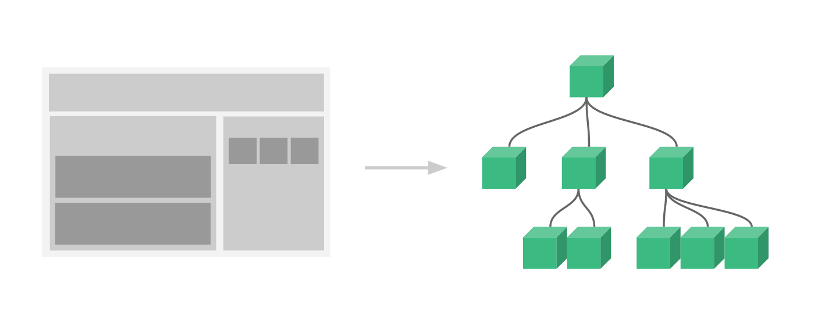
Vue Components
Components are meant to be reusable parts

Slide 5
Single Responsibility Principle
The single-responsibility principle (SRP) is a computer-programming principle that states that every module or class should have responsibility over a single part of the functionality provided by the software, and that responsibility should be entirely encapsulated by the class, module or function.

Slide 6
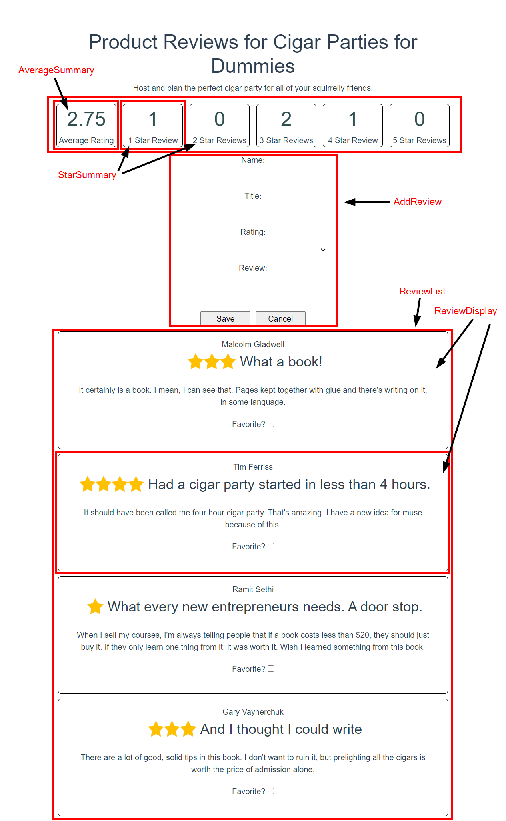
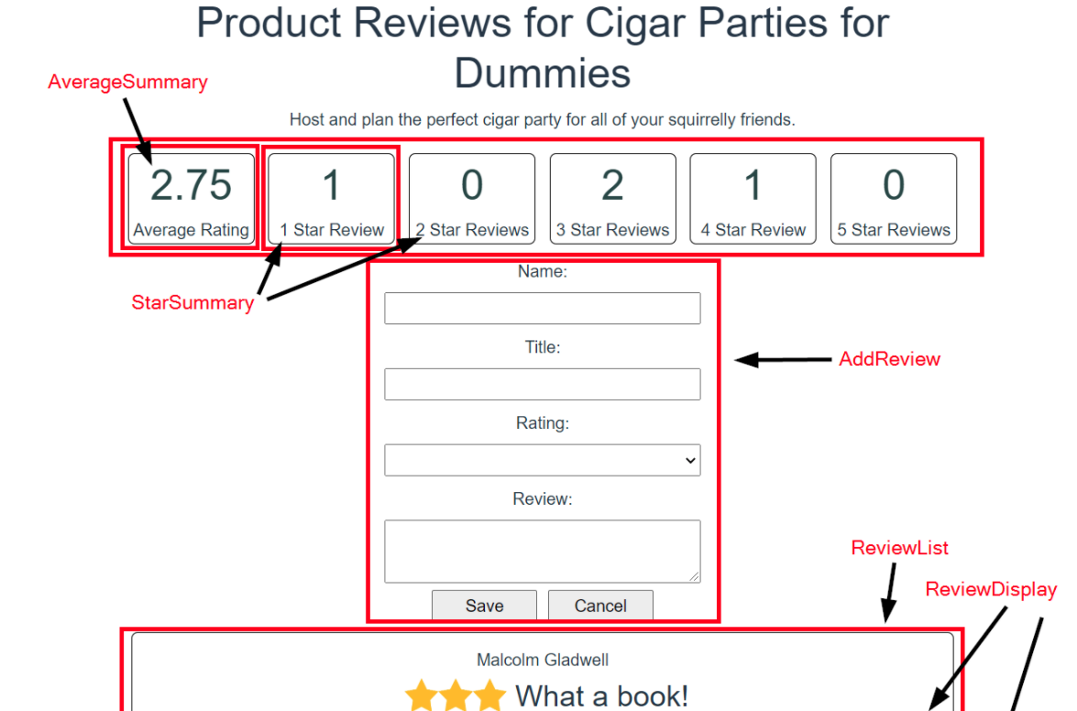

Slide 7
How To Use A Component Inside Another Component
To import and use a component within another component, you need to perform these three steps:
Import the component.
Register the component in the components object.
Use the component in your markup (template).
Ex: App.vue is just a component. Any component can import other components

Slide 8
So how do components share data and work together?

Slide 9
Two Common Ways Components Share Data
Using props (passed in via the tag) HelloWorld Component (inside script section)
<hello-world msg = “this value gets passed in…”/> props { msg: String }
Using Vuex Store

Slide 10
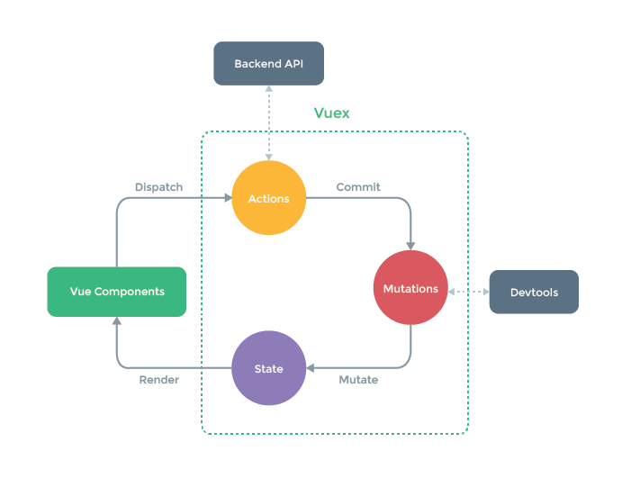
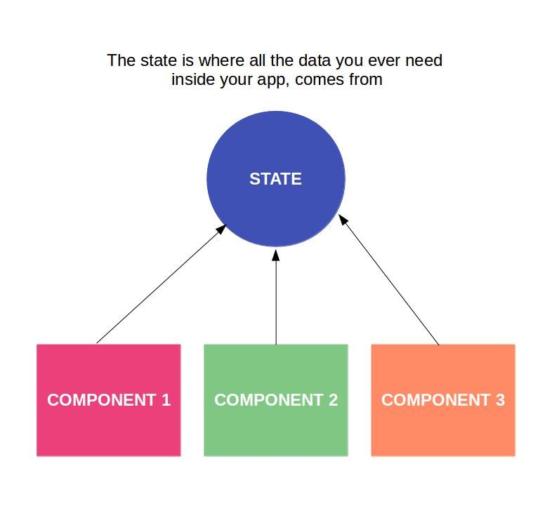
VueX
Vuex is a state management pattern + library for Vue.js applications. It serves as a centralized store for all the components in an application, with rules ensuring that the state can only be mutated in a predictable fashion.
VueX helps us deal with shared state between components with the cost of more concepts and boilerplate code. It’s a trade off between short-term development costs and long term increased productivity.
VueX Documentation

Slide 11
The VueX Store
VueX adds a shared state “store” that will be used by all components in our application. It is divided into 5 major parts.
State
Getters
Mutations
Actions
Modules
Not all parts of the VueX store are needed for an application. Today we will focus on State and Mutations.

Slide 12
VueX Store - State
The State is the data. It contains much of what we added to the data() property of our single component.
It can be accessed from any component using this.$store.state.reviews
When used in a computed property, then then elements bound to the computed property will be reactively updated when the state changes.

Slide 13
VueX Store - Mutations
The value of properties in the state should never be changed directly. Instead they should be changed by committing mutations. A mutation is similar to a setter in a Java class, but adds additional functionality.
Mutations allow for the state to be changed in a way that will be reactive for other components sharing the same state.
Mutations have the added benefit of tracking when and how state was changed. The view Dev Tools can be used to view and manipulate this history, which is invaluable during debugging.

Slide 14
VueX Store - Getters
Vuex allows us to define "getters" in the store. You can think of them as computed properties for stores. Like computed properties, a getter's result is cached based on its dependencies, and will only re-evaluate when some of its dependencies have changed.

Slide 15
VueX Store - Actions
Actions work similar to methods that can be called ( dispatched ) to change state or perform other functionality.
For example, an Action may load data by calling an API before committing a mutation.

Slide 16
VueX Store - Modules
Modules allow for groups of state, mutations, actions, and getters to be encapsulated together similar to a class.
This allows for each module to have responsibility for one segment of the VueX state store.

